Slide 1

AI Model for recycle using energy
Made by:
Abdulkhaliq sarwat 202202084
Ahmed Yasser 202201883
Ahmed Mohamed Abouelela 202202070
Anas Mahmoud Mohamed 202201304

Slide 2

Background and Business Opportunity:
This section provides an overview of the environmental impact of Google's data centers and introduces the proposed project as a solution to address these challenges. It outlines the business opportunity for Google, emphasizing the increasing demand for sustainable solutions.
The opportunity not only aligns with environmental goals but also presents potential cost savings and enhances the company's brand reputation.

Slide 3

Objectives of the Project
This section outlines the primary and secondary objectives of the project in four phases:
● Phase 1 (Research and Planning): Understanding current energy and water usage, developing AI algorithms, and identifying necessary resources.
● Phase 2 (Implementation): Installing AI algorithms, training personnel, and monitoring effectiveness.
● Phase 3 (Optimization): Analyzing data to identify areas for improvement, implementing changes, and evaluating effectiveness.
● Phase 4 (Expansion): Scaling the project to additional data centers, addressing other environmental impacts, and continuous monitoring.
Secondary objectives include cost savings, improved efficiency, sustainability, competitive advantage, and scalability.

Slide 4

Project Constraints
This section identifies constraints to the project's success:
● Scope: Limited to energy and water usage, excluding recycling and waste management.
● Risk: Involving technical challenges, resistance to change, and data privacy concerns.
● Communication Plan: Emphasizing effective communication to address technical challenges and ensure stakeholder engagement.
● Resources: The need for careful management of personnel, equipment, and funding.

Slide 5

How we will manage the risks
This section outlines strategies for risk management:
● Risk Identification: Thoroughly identifying potential risks, both internal and external.
● Risk Mitigation: Implementing strategies to mitigate identified risks.
● Risk Monitoring and Control: Continuous monitoring of risks and implementing control measures.
● Contingency Planning: Developing contingency plans to address unforeseen issues.

Slide 6




Cost:
1. TRAINING THE AI MODEL: UP TO $6 MILLION, AS ESTIMATED BY OPEN AI.
2. IMPLEMENTATION COSTS: INCLUDING INTEGRATION INTO EXISTING INFRASTRUCTURE.
3. MAINTENANCE COSTS: RELATED TO UPDATING KNOWLEDGE BASES AND MONITORING PERFORMANCE.
BENEFITS INCLUDE REDUCED ENERGY CONSUMPTION, SUSTAINABILITY ENHANCEMENT, COST SAVINGS, AND OPTIMIZED RESOURCE USAGE.

Slide 7

Results

Slide 8
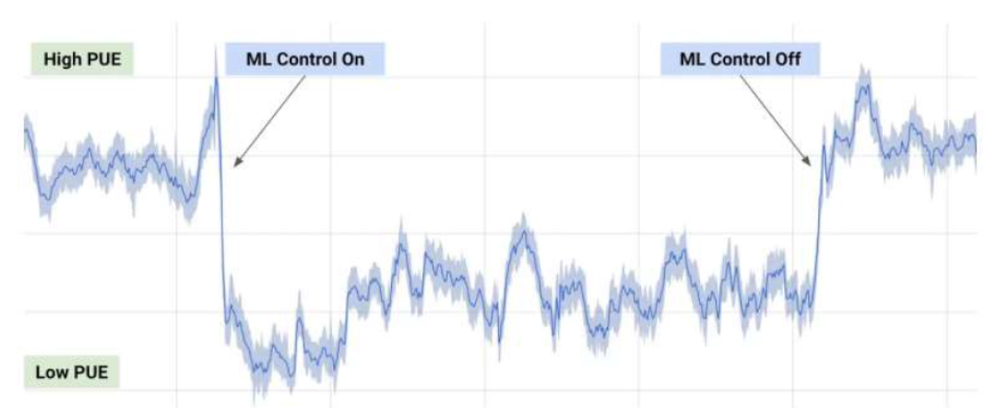
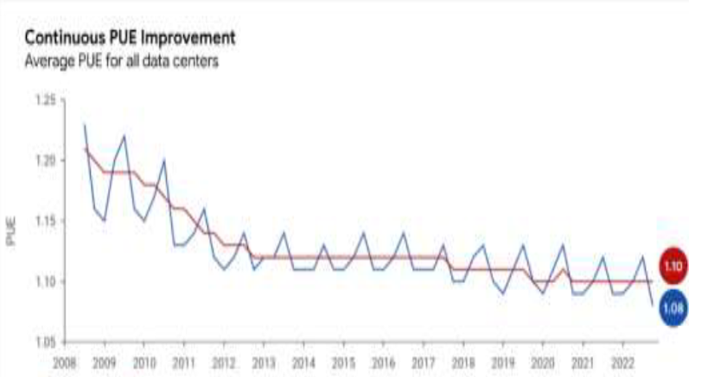
Figures 1 and 2 provide visual representations of the positive impact of implementing AI in Google's data centers.
Figure 1 shows a 40% drop in Power Usage Effectiveness (PUE) after implementing machine learning control.
Figure 2 illustrates continuous improvement in PUE across Google's data centers from 2008 to 2022.

Slide 9

The Logical Framework:

Slide 10

This section introduces the Logical Framework as a tool for project management:
● Purpose: To reduce the environmental impact of Google's data centers through AI algorithms.
● Goals: Reduce energy and water usage, achieve cost savings, enhance reputation and competitiveness, demonstrate sustainability commitment.
● Outcomes: Installation of operational AI algorithms, 20% reduction in energy and water usage, $10 million cost savings, enhanced reputation, and demonstrated commitment to sustainability.
● Assumptions: Effective AI algorithms, proper personnel training, timely and budget-compliant project completion, and support from stakeholders.
The Logical Framework aligns activities with objectives and identifies key assumptions for successful project execution.

Slide 11

thanks

